Slide 1
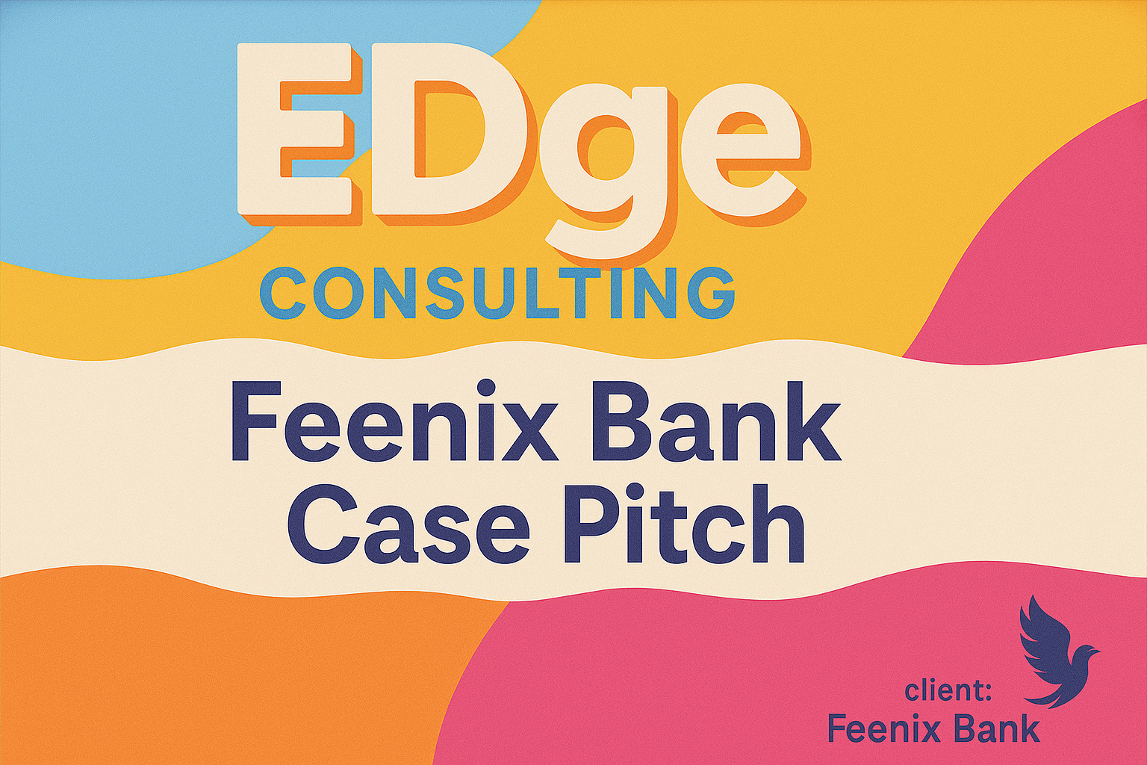
EDge Consulting
Notes:
In a sea of cold, transactional banking apps, Gen Z is looking for something real—something that feels human.
Our strategy is to reposition Feenix not just as a financial institution, but as a brand that gets Gen Z

Slide 2
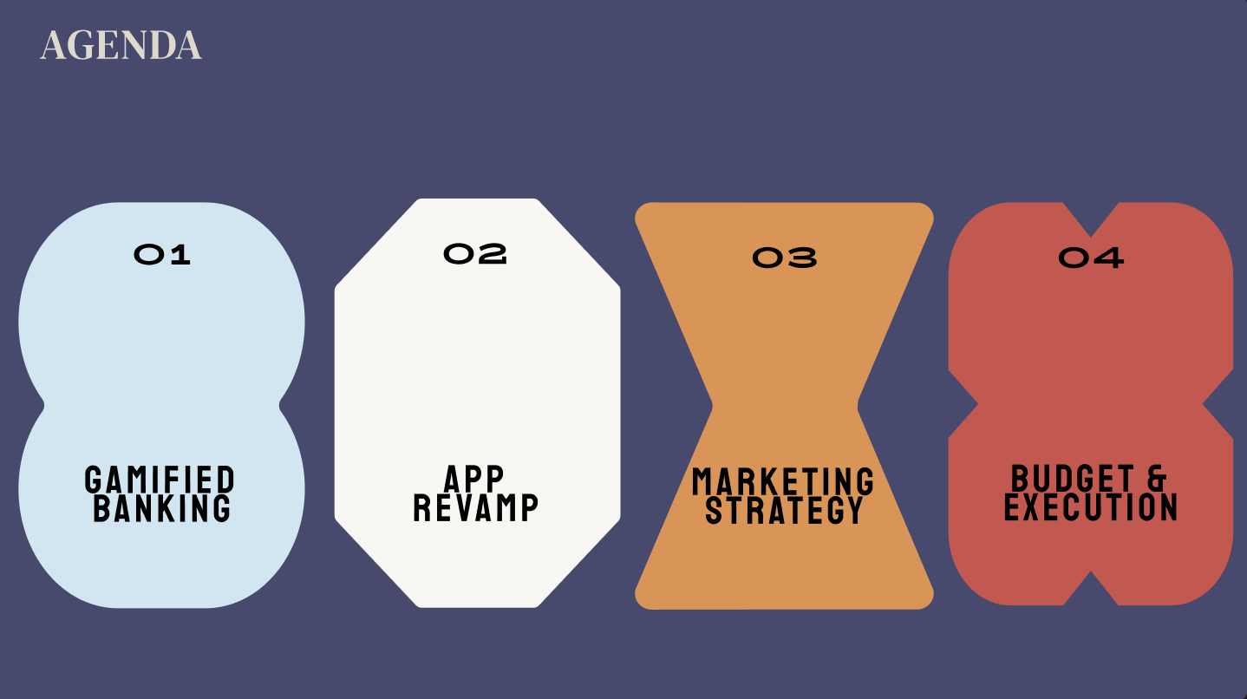
agenda
Notes:
While most big banks go national, we try to take advantage of staying local
Feenix can build loyalty by doubling down on its Southwestern roots.
That means storytelling that reflects local pride

Slide 3
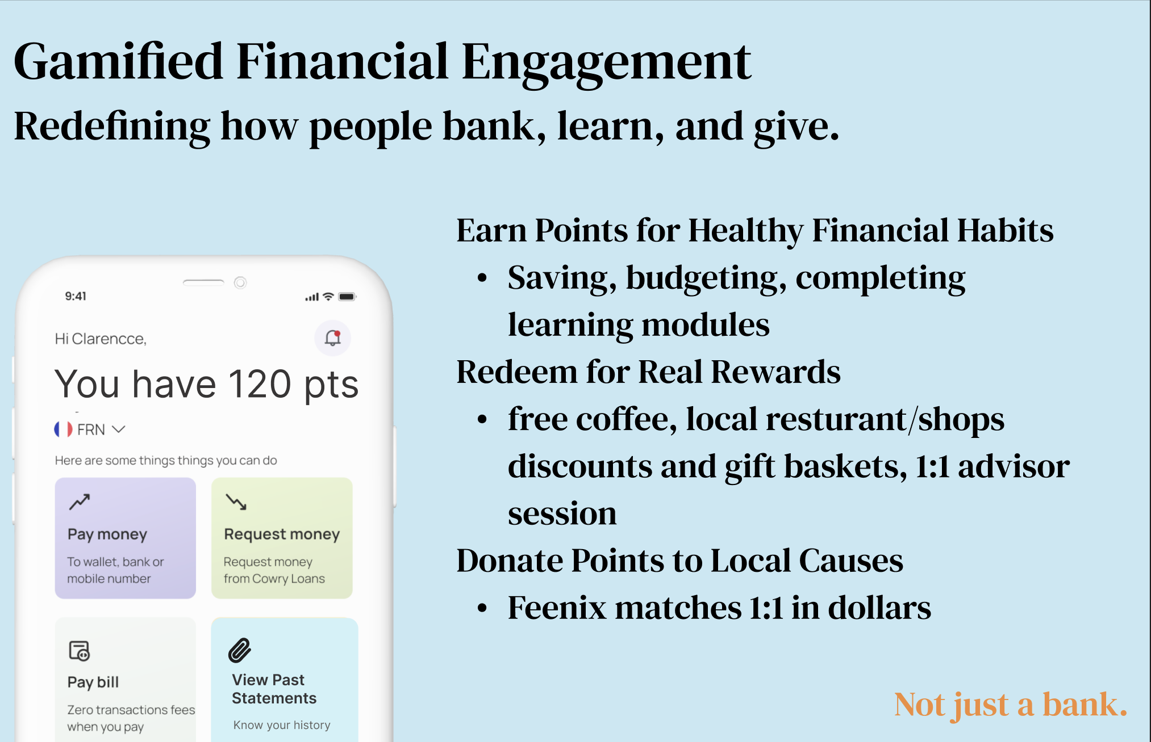

Slide 4
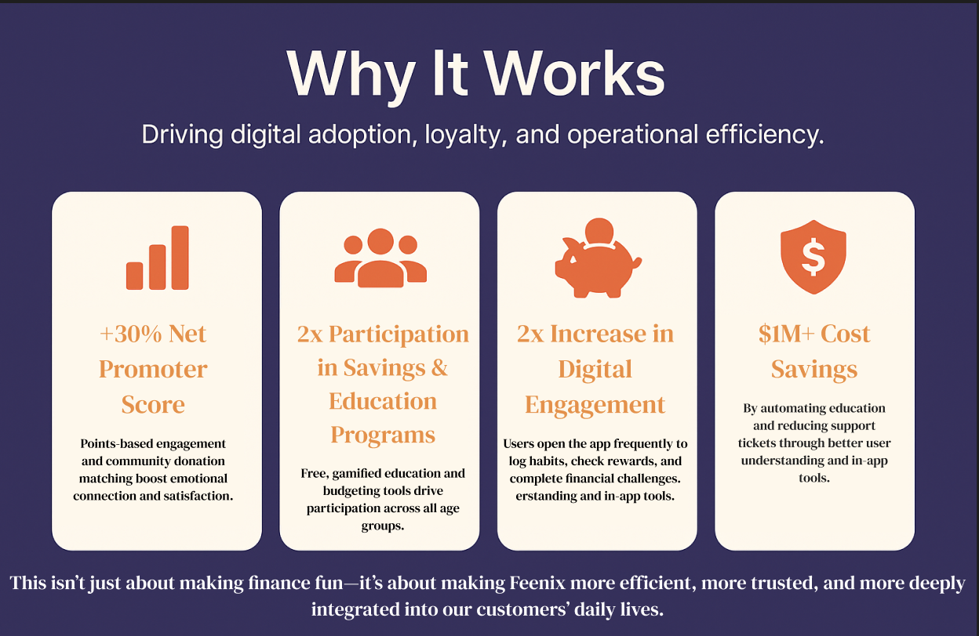

Slide 5
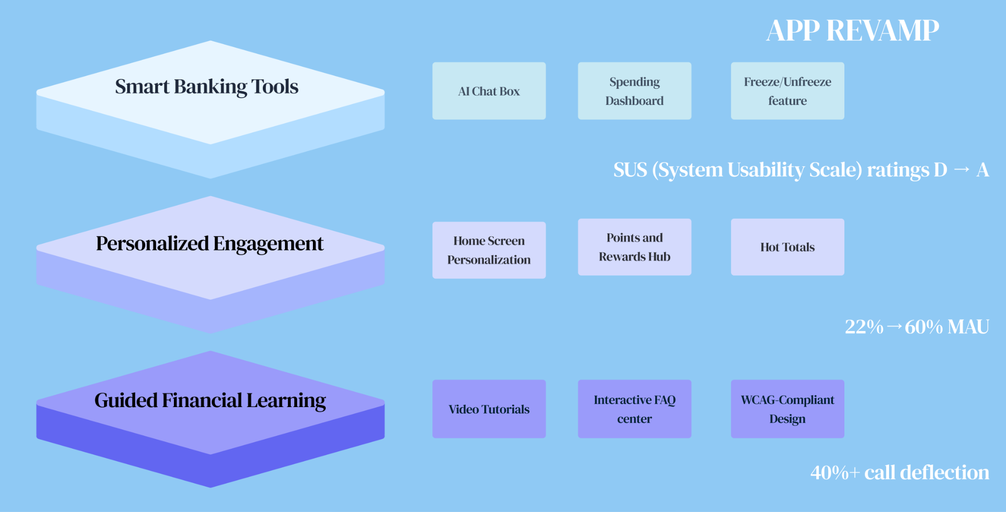

Slide 6
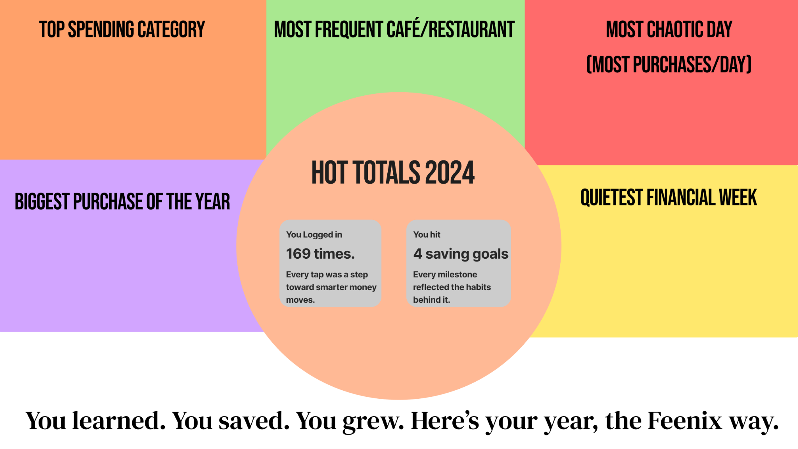

Slide 7
Marketing
Making Feenix Feel Human
Celebrating the Southwest
Shop Local, Bank Local – 10% off at local businesses when savings goals are hit (estimating tool)
The Feenix College Team – Pop-ups with trivia, card sign-ups, financial literacy classes
Creator Collabs – Gen Z stories, budget hacks, sponsored by Feenix
Create Duolingo inspired mascot
Regional storytelling: desert palettes, bilingual content, mini documentaries with clients (Dove, Redbull)
Collabs with creators in Phoenix, Tucson, El Paso, Albuquerque
Limited-edition debit cards with Southwestern designs
Phoenix mascot – Symbol of resilience & rebirth (similar to Duolingo’s mascot)

Slide 8

Feenix Mascot
We estimate:
+35% Gen Z brand awareness across major Southwestern cities (Phoenix, Tucson, El Paso, Albuquerque)
+25% app downloads in target markets through creator campaigns and regional promotions
+20% user retention among Gen Z customers who opt into personalized features
Notes:
To measure success, we focused on metrics tied directly to Gen Z engagement and regional growth.
First, we estimate a +35% lift in brand awareness across our Southwestern target markets—driven by regional creator content and bilingual marketing.
App downloads are projected to rise by 25% in those same cities due to localized campaigns and in-app reward incentives.
Most critically, we project +20% user retention among Gen Z customers who engage with personalized features—custom cards, mascot tools, and financial goal tracking.
These estimates are grounded in outcomes we've seen from comparable fintech and creator-first brands. Feenix isn’t just getting users—it’s keeping them.
1.
Duolingo’s Gen Z TikTok strategy resulted in a 40% increase in app downloads during its peak viral moment (2022-23) (source: Digiday, TechCrunch).
Cash App's local and influencer-based campaigns saw 30%+ regional user growth when partnering with musicians and creators (Forbes, 2021)
2.
Chime and Monzo, both neobank disruptors, report 15–30% higher retention among users who engage with customizable tools (e.g. alerts, branded cards) (Monzo Annual Report, 2021; Chime Product Analytics).
According to McKinsey (2020), personalization in financial services can improve customer engagement by 20%+on average.
3.
Venmo’s custom card launch (2020) saw 40,000+ cards requested in the first few weeks (TechCrunch).
Duolingo’s Owl mascot increased user interaction by 30–40% on posts featuring the character (Sprout Social insights).

Slide 9
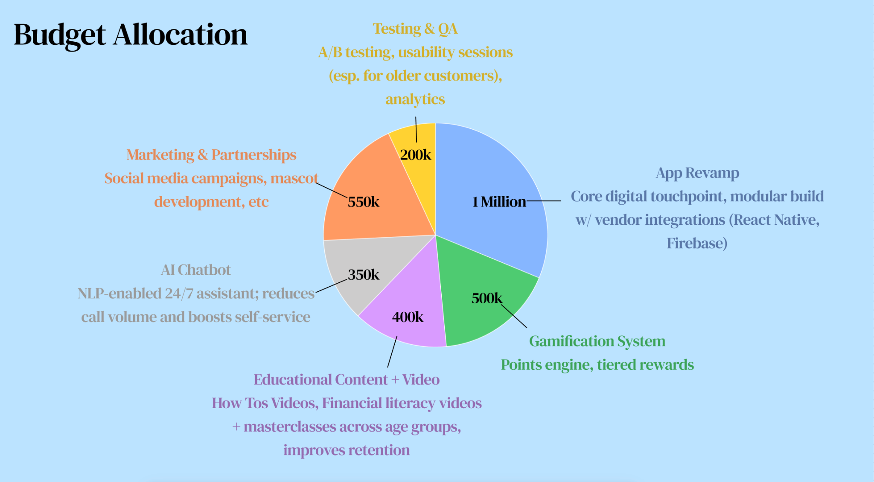
Budget breakdown

